Slide 1



Loops, Arrays, Strings and Objects
Loops, Arrays, Strings and Objects
SoftUni Team
Technical Trainers
Software University
http://softuni.bg

Slide 2
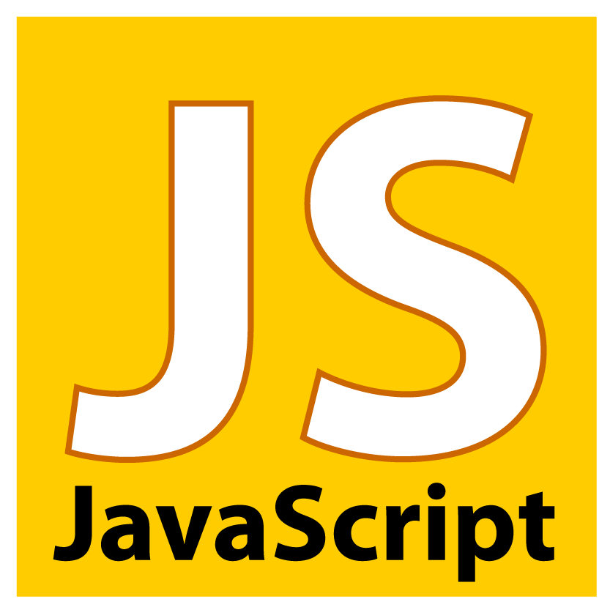

Table of Contents
Loops in JavaScript
while, do-while, for, for-in
Arrays in JavaScript
Declaring and Creating Arrays
Accessing and Processing Array Elements
Associative Arrays, Sorting Arrays
Strings in JavaScript
Processing, Escaping, Trimming, Padding
Objects in JavaScript
lodash.js Library

Slide 3

Loops

Slide 4
Types of Loops in JS
Types of loops in JS
while(…) loop
do { … } while (…) loop
for loop
for-in loop
Infinite loops – a loop that never ends
Nested loops – a composition of loops

Slide 5
How To Use While Loop?
The simplest and most frequently used loop
The repeat condition (loop condition)
The condition is evaluated to true or false
5, "non-empty", etc. are evaluated as true
0, "", null are evaluated as false
while (condition) {
statements;
}

Slide 6
Using Do-While Loop
Another classical loop structure is:
The block of statements is repeated
While the boolean loop condition holds
The loop is executed at least once
do {
statements;
} while (condition);

Slide 7
For Loop – Definition
Initialization
Test
Update
for (var number = 0; number < 10; number++) { // Can use number here } // number is still usable here
Body
Initialization – executed once, just before the loop is entered
Test – checked before each iteration of the loop (loop condition)
Update – executed at each iteration after the loop body
Body – the code that will be executed at each iteration

Slide 8
Using break Operator
The break operator exits the inner-most loop
var n = 5;
var fact = 1;
var factStr = 'n! = ';
while (true) {
if (n == 1)
break;
factStr += n + '*'
fact *= n;
n--;
}
factStr += '1 = ' + fact;
console.log(factStr);

Slide 9

for-in Loop
Iterating over the Properties of an Object

Slide 10
What is for-in Loop?
for-in loop iterates over the properties of an object
For arrays / strings iterates over their indices (0…length-1)
For any other object, for-in iterates over its properties
Iterating over the elements of an array / string:
var arr = [10, 20, 30, 40, 50];
for (var index in arr) { console.log(arr[index]) }
// 10, 20, 30, 40, 50
var str = "welcome";
for (var index in str) { console.log(str[index]) }
// w, e, l, c, o, m, e

Slide 11
For-in Loop
Iterating over the properties of an object:
Typical mistake is to use the key instead of the value:
var obj = { name: 'Steve', age: 23, location: 'Sofia' };
for (var key in obj) { console.log(obj[key]); }
// Steve, 23 , Sofia
var obj = { name: 'Steve', age: 23, location: 'Sofia' };
for (var key in obj) { console.log(key); }
// name, age, location
var arr = [10, 20, 30, 40, 50];
for (var i in arr) { console.log(i); }
// 0, 1, 2, 3, 4

Slide 12
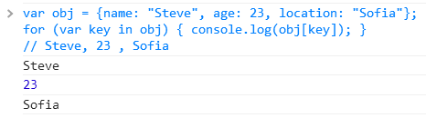
for-in Loop
Live Demo

Slide 13

Arrays

Slide 14
What are Arrays?
An array is an ordered sequence of elements
The order of the elements is fixed
Can get the current length (Array.length)
In JS arrays can change their size at runtime (add / delete)
Element of an array
0 1 2 3 4
Element index
Array of 5 elements
… | … | … | … | …

Slide 15

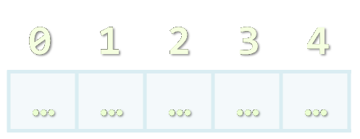

Creating Arrays

Slide 16
Creating Arrays in JavaScript
// Array holding integers
var numbers = [1, 2, 3, 4, 5];
// Array holding strings
var weekDays = ['Monday', 'Tuesday', 'Wednesday',
'Thursday', 'Friday', 'Saturday', 'Sunday'];
// Array of mixed data
var mixedArr = [1, new Date(), 'hello'];
// Array of arrays (matrix)
var matrix = [
['0,0', '0,1', '0,2'],
['1,0', '1,1', '1,2'],
['2,0', '2,1', '2,2']];

Slide 17
Declare and Initialize Arrays
Initializing an array in JavaScript can be done in several ways:
Using new Array(elements):
Using new Array(initialLength):
Using new Array():
Using array literal (recommended):
var arr = new Array(1, 2, 3, 4, 5); // [1, 2, 3, 4, 5]
var arr = new Array(10); // [undefined × 10]
var arr = new Array(); // []
var arr = [1, 2, 3, 4, 5]; // [1, 2, 3, 4, 5]

Slide 18

Accessing Array Elements
Read and Modify Elements by Index

Slide 19
How to Access Array Element?
Array elements are accessed using the [] operator (indexer)
Typically elements are indexed from 0 to arr.length-1
The first element has index 0
The last element has index length-1
Array elements can be retrieved / changed by the [] operator
var arr = [1, 2, 3, 4];
arr[1] = 5;
console.log(arr); // [1, 5, 3, 4]

Slide 20


Working with Arrays
Live Demo

Slide 21
Processing Arrays Using for-Loop
Printing array of integers in reversed order:
Initializing all array elements with their corresponding index:
var array = [1, 2, 3, 4, 5];
for (var i = array.length - 1; i >= 0; i--) {
console.log(array[i]);
}
// Result: 5 4 3 2 1
for (var index = 0; index < array.length; index++) {
array[index] = index;
}

Slide 22

Processing Arrays: for-in
How does for-in loop work?
i iterates through all the indices of array
Can be used when the indices are unknown
E.g. to traverse arbitrary object's properties (not array)
All elements are accessed one by one
The order is not guaranteed
for (var i in array)

Slide 23
Traversing Arrays Using for-in – Example
Print all elements of an array of strings:
var capitals = [
'Sofia',
'Washington',
'London',
'Paris'
];
for (var i in capitals) {
console.log(capitals[i]);
}

Slide 24
Using forEach function
Traditional for-each for arrays might work incorrectly
Functional forEach is preferred by JavaScript developers because of it’s better performance
var capitals = [
'Sofia',
'Washington',
'London'
];
capitals.forEach(function(capital) {
console.log(capital)
});

Slide 25
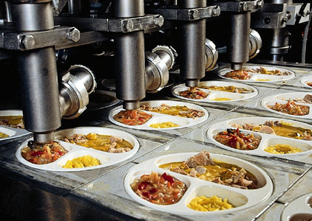
Processing Arrays
Live Demo

Slide 26
Arrays in JS are Dynamic (Resizable)
All arrays in JavaScript are dynamic (dynamically-resizable)
Their size can be changed at runtime through append / insert / delete
Methods for array manipulation:
array.push(element) – appends a new element at the end
array.pop() – removes and returns the last element
array.unshift(element) – inserts a new element at the beginning of the array
array.shift() – removes and returns the element at the beginning of the array

Slide 27
Append / Insert / Delete from Array
var numbers = [1, 2, 3, 4, 5];
console.log(numbers.join('|')); // result: 1|2|3|4|5
var tail = numbers.pop(); // tail = 5;
console.log(numbers.join('|')); // result: 1|2|3|4
numbers.unshift(0);
console.log(numbers.join('|')); // result: 0|1|2|3|4
var head = numbers.shift(); // head = 0;
console.log(numbers.join('|')); // result: 1|2|3|4

Slide 28
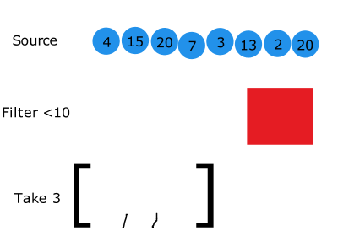
Array filter()
The array.filter() method creates a new array filtered by a provided function
function isBigEnough(element) {
return element < 10;
} // declaring callback function
var filtered =
[4, 15, 20, 7, 3].filter(isBigEnough);
// filtered array is [4, 7, 3]

Slide 29
Array map()
The array.filter() method creates a new array with the results of calling a provided function on every element in this array.
var numbers = [1, 4, 9];
var doubles = numbers.map(function(num) {
return num * 2;
});
// doubles is now [2, 8, 18]. numbers is still [1, 4, 9]

Slide 30
Push / Pop / Unshift / Shift
Live Demo

Slide 31
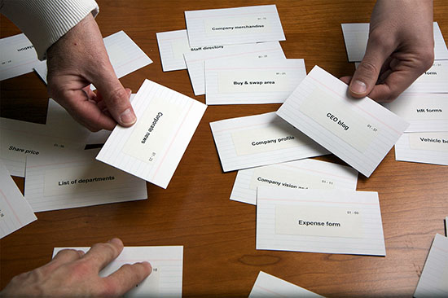
Sorting Arrays
Array.sort() and Array.sort(orderBy)

Slide 32
Sorting Arrays in JavaScript
array.sort()
Sorts the elements of the array (in ascending order)
Compares the elements by their string representation!
i.e. the number 23 is compares as the string "23"
Not quite sorted, right?
var numbers = [5, 4, 2, 3, 1, 4, 5, 6, 7];
numbers.sort();
console.log(numbers.join(', '));
// result: 1, 2, 3, 4, 4, 5, 5, 6, 7
var numbers = [5, 4, 23, 2];
numbers.sort();
console.log(numbers.join(', ')); // result: 2, 23, 4, 5

Slide 33
Sorting Arrays with Compare Function
array.sort(compareFunc)
Sorts element using a compare function
The compare function defines the sorting rules
Return negative or 0 to leave the elements
Return positive to swap them
var numbers = [5, 4, 23, 2];
numbers.sort(function(a, b) {
return a > b;
});
console.log(numbers.join(', '));
// returns 2, 4, 5, 23

Slide 34
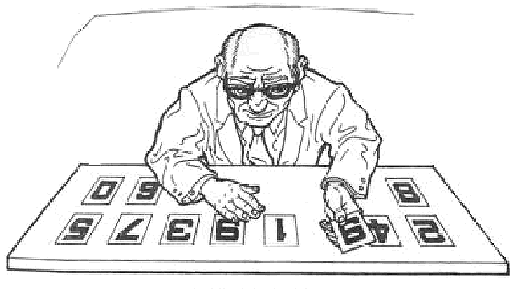
Sorting Arrays
Live Demo

Slide 35
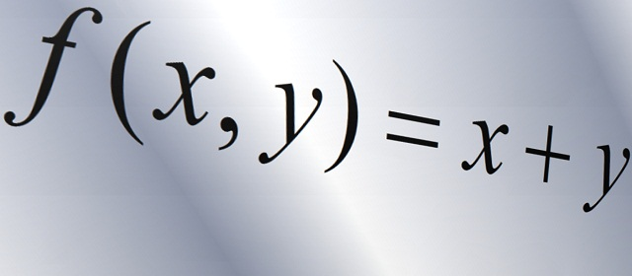
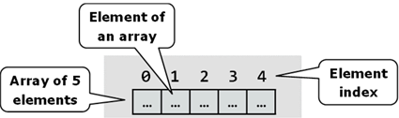
Other Array Functions

Slide 36
Other Array Functions
array.reverse()
Returns a new arrays with elements in reversed order
array.slice(start, end)
Extracts elements from an array (start…end-1)
array.concat(elements)
Appends elements at the end of the array
array.join(separator)
Concatenates the elements of the array

Slide 37
Other Array Functions (2)
array.filter(function(item){ return true / false })
Returns a new array with the elements that satisfy condition
array.forEach(function(item){ … })
Iterates through the array and executes the function for each item
array.indexOf(element)
Returns the index of the first match in the array
Returns -1 is the element is not found
array.lastIndexOf(element)
Returns the index of the first match in the array or -1 (not found)

Slide 38
Other Array Functions
Live Demo

Slide 39
Arrays – Additional Information
Arrays official documentation:
https://developer.mozilla.org/en-US/docs/Web/JavaScript/Reference/Global_Objects/Array
Checking for array
typeof([1, 2, 3]) → object
Array.isArray([1, 2, 3]) → true

Slide 40
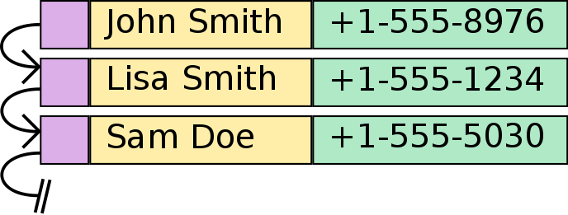
Associative Arrays

Slide 41
Associative Arrays (Maps, Dictionaries)
Associative arrays in JavaScript are called Objects holding a set of key-value pairs
Traditional array
Associative array
key
value
key
0 1 2 3 4
orange | 2.30
apple | 1.50
tomato | 3.80
value
8 | -3 | 12 | 408 | 33

Slide 42
Associative Arrays in JavaScript
Initializing an associative array (object):
Accessing elements by index:
Inserting a new element / deleting element:
Objects are not arrays → no length, no slice(), no join(), …
var prices = { 'orange' : 2.30, 'apple' : 1.50, 'tomato' : 3.80 };
console.log(prices['orange']); // 2.3
prices['cucumber'] = 1.25;
delete prices['orange'];
console.log(prices); // {apple: 1.5, tomato: 3.8, cucumber: 1.25}

Slide 43
Processing Associative Arrays
Processing associative arrays (objects) by for-in loop
Taking the keys of object / array:
var prices = {'orange' : 2.30, 'apple' : 1.50, 'tomato' : 3.80 };
for (key in prices) {
console.log(key + ' -> ' + prices[key]);
}
var prices = { 'orange' : 2.30, 'apple' : 1.50, 'tomato' : 3.80 };
console.log(Object.keys(prices)); // ["orange", "apple", "tomato"]
var nums = [10, 20, 30];
console.log(Object.keys(nums)); // ["0", "1", "2"]

Slide 44

Strings
Working with Strings in JavaScript

Slide 45
Strings in JavaScript
A string is a sequence of characters
Text enclosed in single (' ') or double quotes (" ")
var str1 = "Some text in a string variable";
var str2 = 'Text enclosed in single quotes';
String is a primitive type
It is copied / passed by value
String is also immutable
Every time a string is changed, a new string is created

Slide 46
String Methods
string.length
Returns the number of characters in the string
Indexer (string[index])
Gets a single-character string at location index
If index is out of range, returns undefined
string[-1] or string[string.length] → undefined
charAt(index)
Gets a single-character string at location index (just like [])

Slide 47
String Methods (2)
string.concat(anotherString)
Returns a new string – the concatenation of the two strings
string.replace(str1, str2)
Replaces first occurrence of str1 with str2
string.search(regex)
Searches for a substring based on regular expression
var s = 'My mail is email@host.com, please contact me';
var emailIndex = s.search(/\S+@\S+/); // 11

Slide 48
String Methods (3)
string.indexOf(substring [, position])
Returns the left-most occurrence of substring (after the position)
Position is optional and has default value of 0
If string doesn't contain substring, returns -1
string.lastIndexOf(substring [, position])
Returns the right-most occurrence of substring (before position)
Position is optional, default value is string.length
If string doesn't contain substring, returns -1

Slide 49
String Methods (4)
string.substr(start[, length])
Returns a substring by start and length (length is optional)
string.substring(start, end)
Returns a substring, starting from start and ending at end
string.valueOf()
Returns the primitive value of the object string
str.trim(), str.trimLeft(), str.trimRight()
Removes the whitespace from the start / end of the string

Slide 50
String Methods (5)
string.split(separator)
Splits the string by separator and returns an array of strings
Separator can be a regular expression, e.g. s.split(/[\s,]+/)
var tokens = 'C#, Java, PHP ,HTML'.split(',');
// tokens = ['C#', ' Java', ' PHP ', 'HTML']
var tokens = 'C#, Java, PHP;\n JS'.split(/[\s,;]+/);
// tokens = ['C#', 'Java', 'PHP', 'JS']

Slide 51
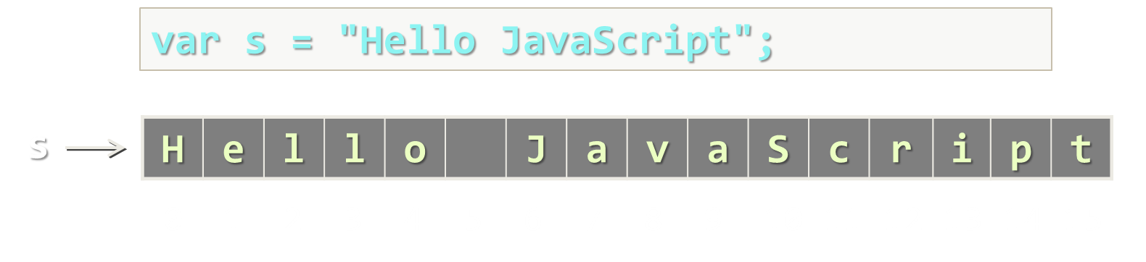
String Methods
Live Demo

Slide 52
String Wrapper
As string is a primitive type, it has a object wrapper type
Primitive types keep only their value
When a property / method is called, the JS engine converts the primitive into its corresponding object type and calls the property
var str = 'sample';
var tempStr = new String(str);
tempStr.length;
var str = 'sample';
str.length;
same as
String.prototype.len2 = function() { return this.length * 2; }
var lenTwice = 'hello'.len2(); // 10

Slide 53
From Object to Primitive Type
JavaScript have a simple parsing from string to number:
Conversion from primitive to object type:
new String('…') creates a string object
String(strObject) creates a primitive string
var str = '42';
var num = Number(str); // 42
var base = 'string'; // "string"
var strObj = new String(base);
// String {0: "s", 1: "t", 2: "r", 3: "i", 4: "n", 5: "g"}
var str = String(strObj); // "string"

Slide 54
String Concatenation
Live Demo

Slide 55

HTML Escaping

Slide 56
String Escaping
What is escaping?
Replacing reserved characters with their escape sequence
Prevents JavaScript injection
When using JavaScript client-side reserved characters are '<', '>', '&', "'" and '"'
document.body.append(
'<script>' +
'document.location = 'http://bad_place.com' +
'</script>');

Slide 57
String Escaping (2)
Escaping is done by just replacing the reserved characters with their escape sequence
Can be attached to the string prototype
String.prototype.htmlEscape = function() {
var escapedStr = String(this).replace(/&/g, '&amp;');
escapedStr = escapedStr.replace(/</g, '&lt;');
escapedStr = escapedStr.replace(/>/g, '&gt;');
escapedStr = escapedStr.replace(/"/g, '&quot;');
escapedStr = escapedStr.replace(/'/g, '&#39');
return escapedStr;
}

Slide 58
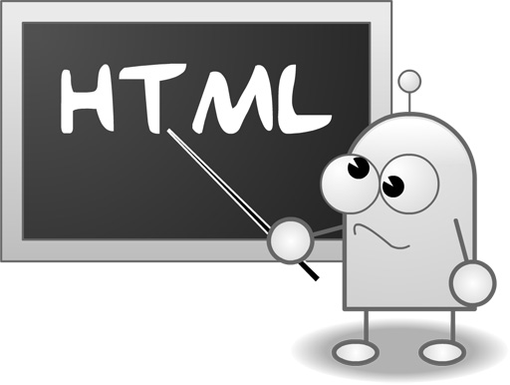
HTML Escaping
Live Demo

Slide 59

Object Types and Objects
Modeling Real-world Entities with Objects

Slide 60
What are Objects?
Software objects model real-world objects or abstract concepts
Examples:
bank, account, customer, dog, bicycle, queue
Real-world objects have state and behavior
Account's state:
holder, balance, type
Account's behavior:
withdraw, deposit, suspend

Slide 61
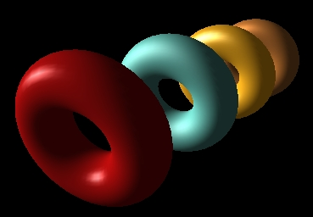
What are Objects? (2)
How do software objects implement real-world objects?
Use variables / data to implement state
Use methods / functions to implement behavior
An object is a software bundle of variables and related functions
account
owner: "Peter"
balance: 350.00
state (data)
function deposit(sum)
function withdraw(sum)
behavior (functions)

Slide 62
Objects Represent
 checks
 people
 shopping list
…
 numbers
 characters
 queues
 arrays
Things / concepts from the real world
Things / concepts from the computer world

Slide 63
What is an Object Type (Class)?
The formal definition of a object type (class):
Definition by Google
Object types act as templates from which an instance of an object is created at run time. Types define the properties of the object and the functions used to control the object's behavior.

Slide 64
Object Types
Object types provide the structure for objects
Define their prototype, act as template
Object types define:
Set of attributes
Represented by variables and properties
Hold their state
Set of actions (behavior)
Represented by methods/functions

Slide 65
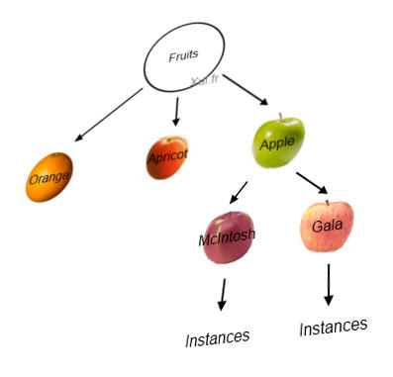
Objects
An object is a concrete instance of a particular object type
Creating an object from an object type is called instantiation
Objects have state
Set of values associated to their attributes
Example:
Type: Account
Objects: Ivan's account, Peter's account

Slide 66
Object Types and Objects – Example
Attributes
(properties and fields)
Object
ivanAccount
Object type
owner = "Ivan Kolev"
balance = 5000.0
Account
Object
peterAccount
owner
balance
owner = "Peter Kirov"
balance = 1825.50
suspend()
deposit(sum)
withdraw(sum)
Object
kirilAccount
owner = "Kiril Kirov"
balance = 25.0
Operations (functions)

Slide 67
JavaScript Objects Overview
JS
What are Objects?

Slide 68
Objects Overview
JavaScript is designed on a simple object-based paradigm
An object is a collection of properties
An object property is association between a name and a value
A value of property can be either
Property (variable / field)
Function (method)
Lots of predefined (native) objects available in JS
Math, document, window, etc…
Objects can be created by the developer

Slide 69
Objects in JS – Example
var tom = {
firstName: 'Tom',
lastName: 'Miller',
toString: function () {
return this.firstName + " " + this.lastName;
}
}
var kate = {
firstName: 'Kate',
lastName: 'Brown',
toString: function () {
return this.firstName + " " + this.lastName;
}
}

Slide 70
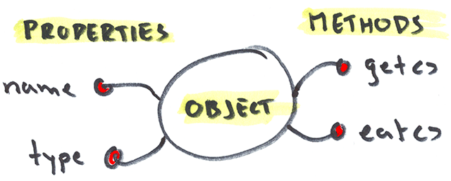
Objects and Properties
Live Demo

Slide 71
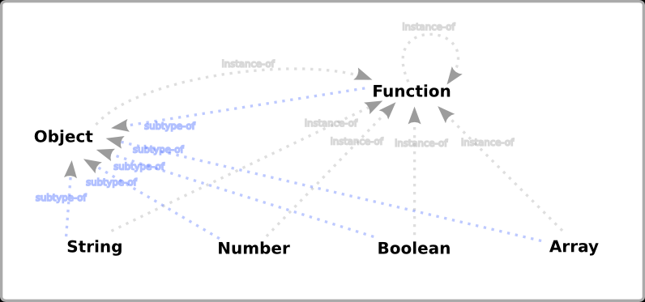
Object and Primitive Types
Types in JavaScript

Slide 72
Reference and Primitive Types
JavaScript is a typeless language
Variables don’t have type, but their values do
JavaScript has six different types:
number, string, boolean, null, undefined and object
Object is the only Object type
It is copied by reference
number, string, boolean, null, undefined are primitive types
Copied by value

Slide 73
Reference and Primitive Types (2)
The primitive types are boolean, number, string, undefined and null
All the other types are actually of type object
Including arrays, dates, custom types, etc…
All types derive from object
Their type is object
console.log(typeof new Object() === typeof new Array()); // true
console.log(typeof new Object() === typeof new Date()); // true
console.log(typeof new Array() === typeof new Date()); // true

Slide 74
Primitive Types
Primitive types are passed by value
When passed as argument
New memory is allocated
The value is copied in the new memory
The value in the new memory is passed
Primitive types are initialized with type literals
Primitive types have an object type wrapper
var number = 5;
var text = 'Hello there!';

Slide 75
Primitive Types – Example
Assign string values to two variables
Create an object using their value
Change the value of the variables
Each object has its own value
var fName = 'Pesho';
var lName = 'Ivanov';
var person = { firstName: fName, lastName: lName };
lName = 'Petrov';
console.log(person.lastName) // logged 'Ivanov'

Slide 76

Primitive and Reference Types in JS
primitive
reference
Live Demo

Slide 77
Object Type
Except primitives, all other types are objects
When passed to a function, the value is not copied, but instead a reference of it is passed
var marks = [
{ subject : 'Java', score : 6.00 },
{ subject : 'HTML5', score : 5.90 },
{ subject : 'JavaScript', score : 6.00 },
{ subject : 'PHP', score : 6.00 }];
var student = { name: 'Deyan Dachev', marks: marks };
marks[1].score = 5.50;
console.log(student.marks[1]); // logs 5.50 for HTML5 score

Slide 78
Object Cloning
Shared object – two variables holding the same object:
Cloned objects – two variables holding separate objects:
var peter = { name: 'Peter', age: 21 };
var maria = peter;
maria.name = 'Maria';
console.log(maria); // Object {name: "Maria", age: 21}
console.log(peter); // Object {name: "Maria", age: 21}
var peter = { name: 'Peter', age: 21 };
var maria = JSON.parse(JSON.stringify(peter));
maria.name = 'Maria';
console.log(maria); // Object {name: "Maria", age: 21}
console.log(peter); // Object {name: "Peter", age: 21}

Slide 79
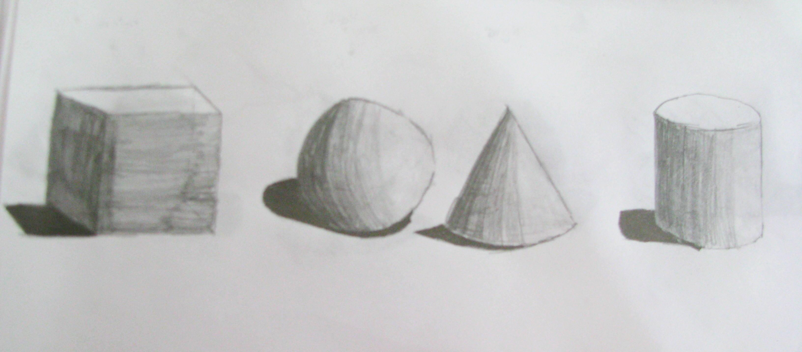
Object Types
Live Demo

Slide 80

JSON Objects
Creating Simple objects

Slide 81
JSON Objects
JSON stands for JavaScript Object Notation
A data format used in JavaScript, the "prop:value" notation
var person = {
firstName: 'Dicho',
lastName: 'Dichov',
toString: function personToString() {
return this.firstName + ' ' + this.lastName;
}
}

Slide 82
JS Object ↔ JSON String
JSON.stringify(obj)
Converts a JS object to JSON string:
JSON.parse(str)
Creates a JS object by JSON string:
var obj = { town: 'Sofia', gps: {lat: 42.70, lng: 23.32} }
var str = JSON.stringify(obj);
var str = '{"town":"Sofia","gps":{"lat":42.70,"lng":23.32}}';
var obj = JSON.parse(str);
// both lines below throw SyntaxError
JSON.parse('{foo:"bar"}');
JSON.parse("{'foo':'bar'}");

Slide 83
Building a JSON Object
JSON is great, but repeating code is not, right?
Lets make several people:
var dicho = {fname: 'Dicho', lname: 'Dichov',
toString: function() { return this.fname + ' ' + this.lname; }
}
var georgiev = { fname: 'Georgi', lname: 'Georgiev', toString: function() { return this.fname + ' ' + this.lname; }
}
var kirova = { fname: 'Maria', lname: 'Kirova', toString: function() { return this.fname + ' ' + this.lname; }
}

Slide 84
JSON Building Function
A function for building JSON objects
Just pass first and last name and get an object
Something like a constructor
function BuildPerson(fname, lname) {
return {
fname: fname,
lname: lname,
toString: function () { return this.fname + ' ' + this.lname; }
}
}
var minkov = BuildPerson('Dicho', 'Dichov');
var georgiev = BuildPerson('Georgi', 'Georgiev');

Slide 85
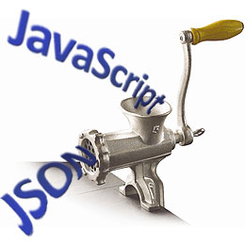
JSON Objects
Live Demo

Slide 86

Lo-Dash

Slide 87
What is lodash.js?
A JavaScript utility library delivering consistency, modularity, performance & extras.
Download link https://raw.github.com/lodash/lodash/3.3.1/lodash.js
_.assign({ 'a': 1 }, { 'b': 2 }, { 'c': 3 }); // → { 'a': 1, 'b': 2, 'c': 3 } _.map([1, 2, 3], function(n) { return n * 3; }); // → [3, 6, 9]

Slide 88
What do we use Lo-Dash for?
Lo-Dash (and it’s older cousin Underscore.js) provide functional programming library
array manipulation
collections manipulation
function customization
object creation
string manipulation
and many more…

Slide 89
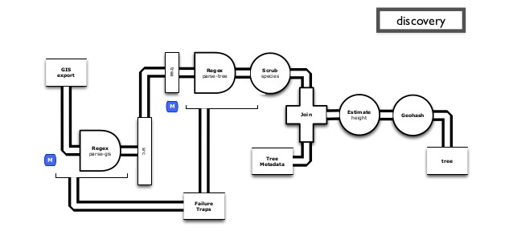

Lo-Dash
Live Demo

Slide 90


Summary
Loops in JavaScript (Same as in C#, Java, C++ )
Functional forEach()
Arrays in JavaScript
We can have array of elements from different types
Dynamic Arrays, Associative Arrays, Sorting
Strings in JavaScript
String Concatenation, String Wrapper, HTML Escaping
Objects in JavaScript
Lo-Dash Library for performance
JS Basics

Slide 91







Loops, Arrays and Strings
https://softuni.bg/courses/javascript-basics

Slide 92
License
This course (slides, examples, demos, videos, homework, etc.) is licensed under the "Creative Commons Attribution-NonCommercial-ShareAlike 4.0 International" license
Attribution: this work may contain portions from
“JavaScript Basics" course by Telerik Academy under CC-BY-NC-SA license

Slide 93





Free Trainings @ Software University
Software University Foundation – softuni.org
Software University – High-Quality Education, Profession and Job for Software Developers
softuni.bg
Software University @ Facebook
facebook.com/SoftwareUniversity
Software University @ YouTube
youtube.com/SoftwareUniversity
Software University Forums – forum.softuni.bg

